Slide 1
Rear Proximity Sensor
Jacob Barbee, Christopher Hoole

Slide 2
Problem Statement
130k cyclist injuries occur on-road annually (1)
Roughly 1,000 deaths
64% of deaths happen far from intersections
$23B total spent due to these accidents
Responsibility could be placed on state agencies, vehicle manufacturers, and on the cyclists themselves
Notes:
Read slide then elaborate on different ways to improve these statistics. Whether placing the responsibility on transportation agencies to make roads more “bike friendly”, making vehicle manufacturers produce more bike friendly features for their products, or by giving bicyclists access to proper protective measures, which is where we decided to place our focus.

Slide 3
Existing Solutions
On-Vehicle Image Detection System (2009) [2]
Chen & Chen at the Research and Development Division, Automotive Research and Testing Center, Taiwan
Uses image detection to detect other cars in blind spot areas on vehicles
Connected Bicycles (2016) [4]
Piramuthu at Buchholz High School, Gainesville, FL
Smart vehicles and bikes as an IoT sharing routing information
Bicycle Blind Spot Detection System (2016) [3]
Johnston, Gordon, and May at the University of British Columbia
Uses Sonar to detect objects and lights up an LED when object in close proximity
Note: None use a mobile phone component
Notes:
The one common area that seems to be overlooked by these solutions is the employment of mobile computing potential, which is where Jake and I have intervened.

Slide 4
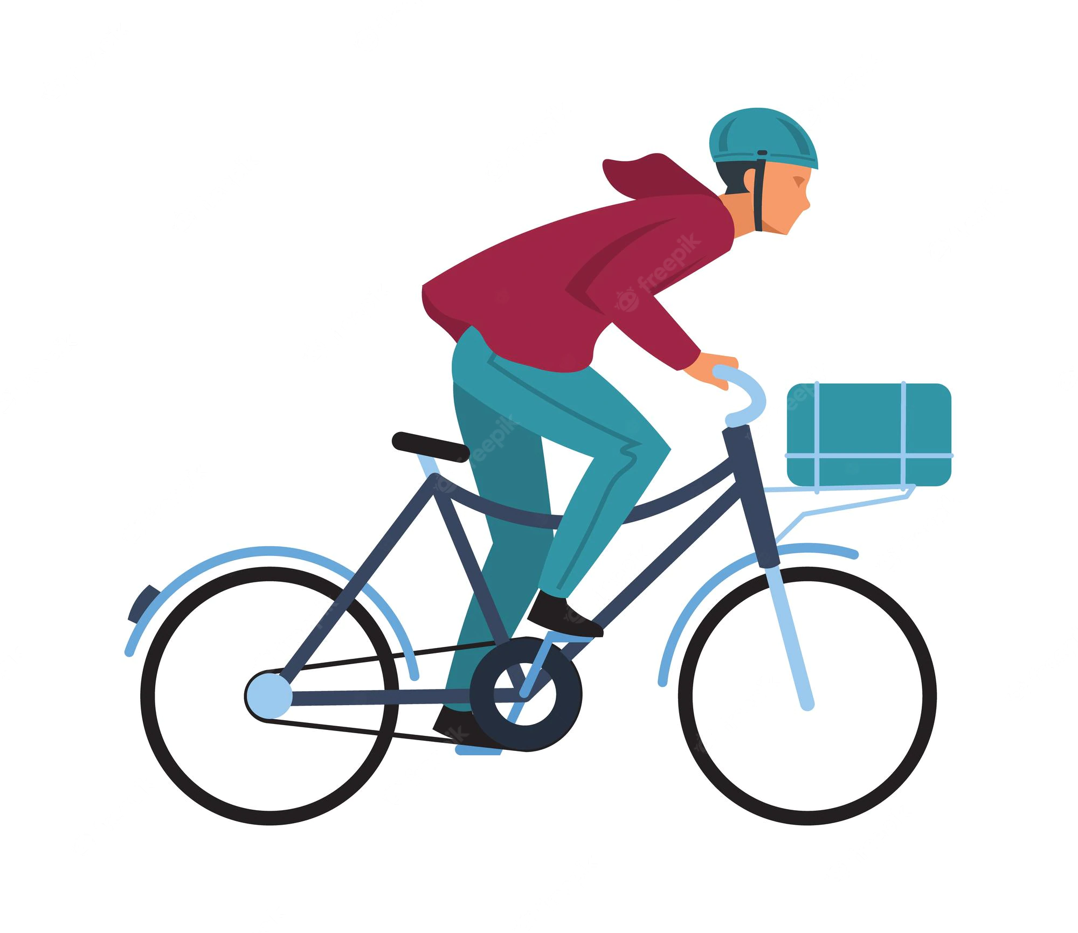
High-Level Design
Sensor Module w/ seat mount
Mobile device w/ handlebar mount
Bluetooth Connection between sensor module & mobile device
Notes:
The way it works is the module is connected to the bike seat and will be constantly sending out an acoustic signal and once an object comes within a certain range it will send an alert to the mobile device.
Note: Since we don’t extensive knowledge of mobile programming, we have constructed a preliminary prototype that utilizes an arduino, acoustic sensor and an LED. The state of the LED will simulate the signal sent to the mobile devices as the bluetooth connection to a mobile device will be assumed.

Slide 5

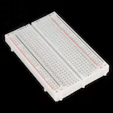
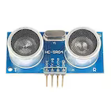
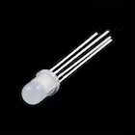
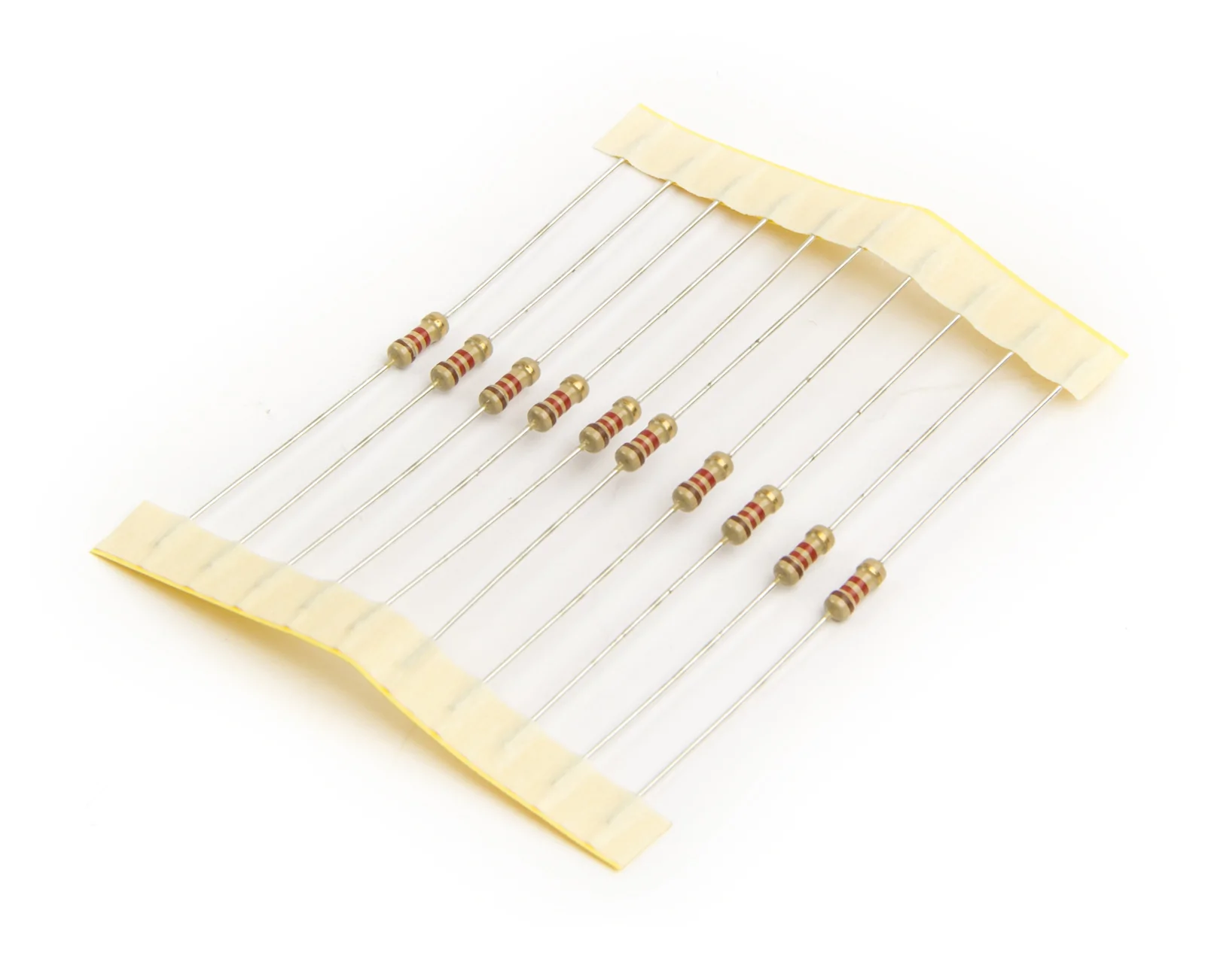
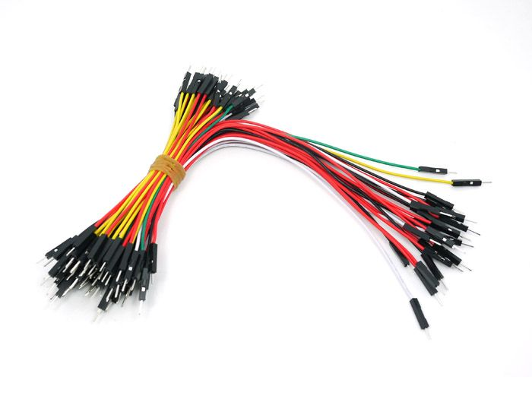
Circuit Design
Materials
1x Elegoo Uno R3
1x Breadboard
1x HC-SR04
1x Common Cathode RGB LED
3x 220 ohm resistors
10x Jumper Wires
All images from https://www.arduino.cc/

Slide 6
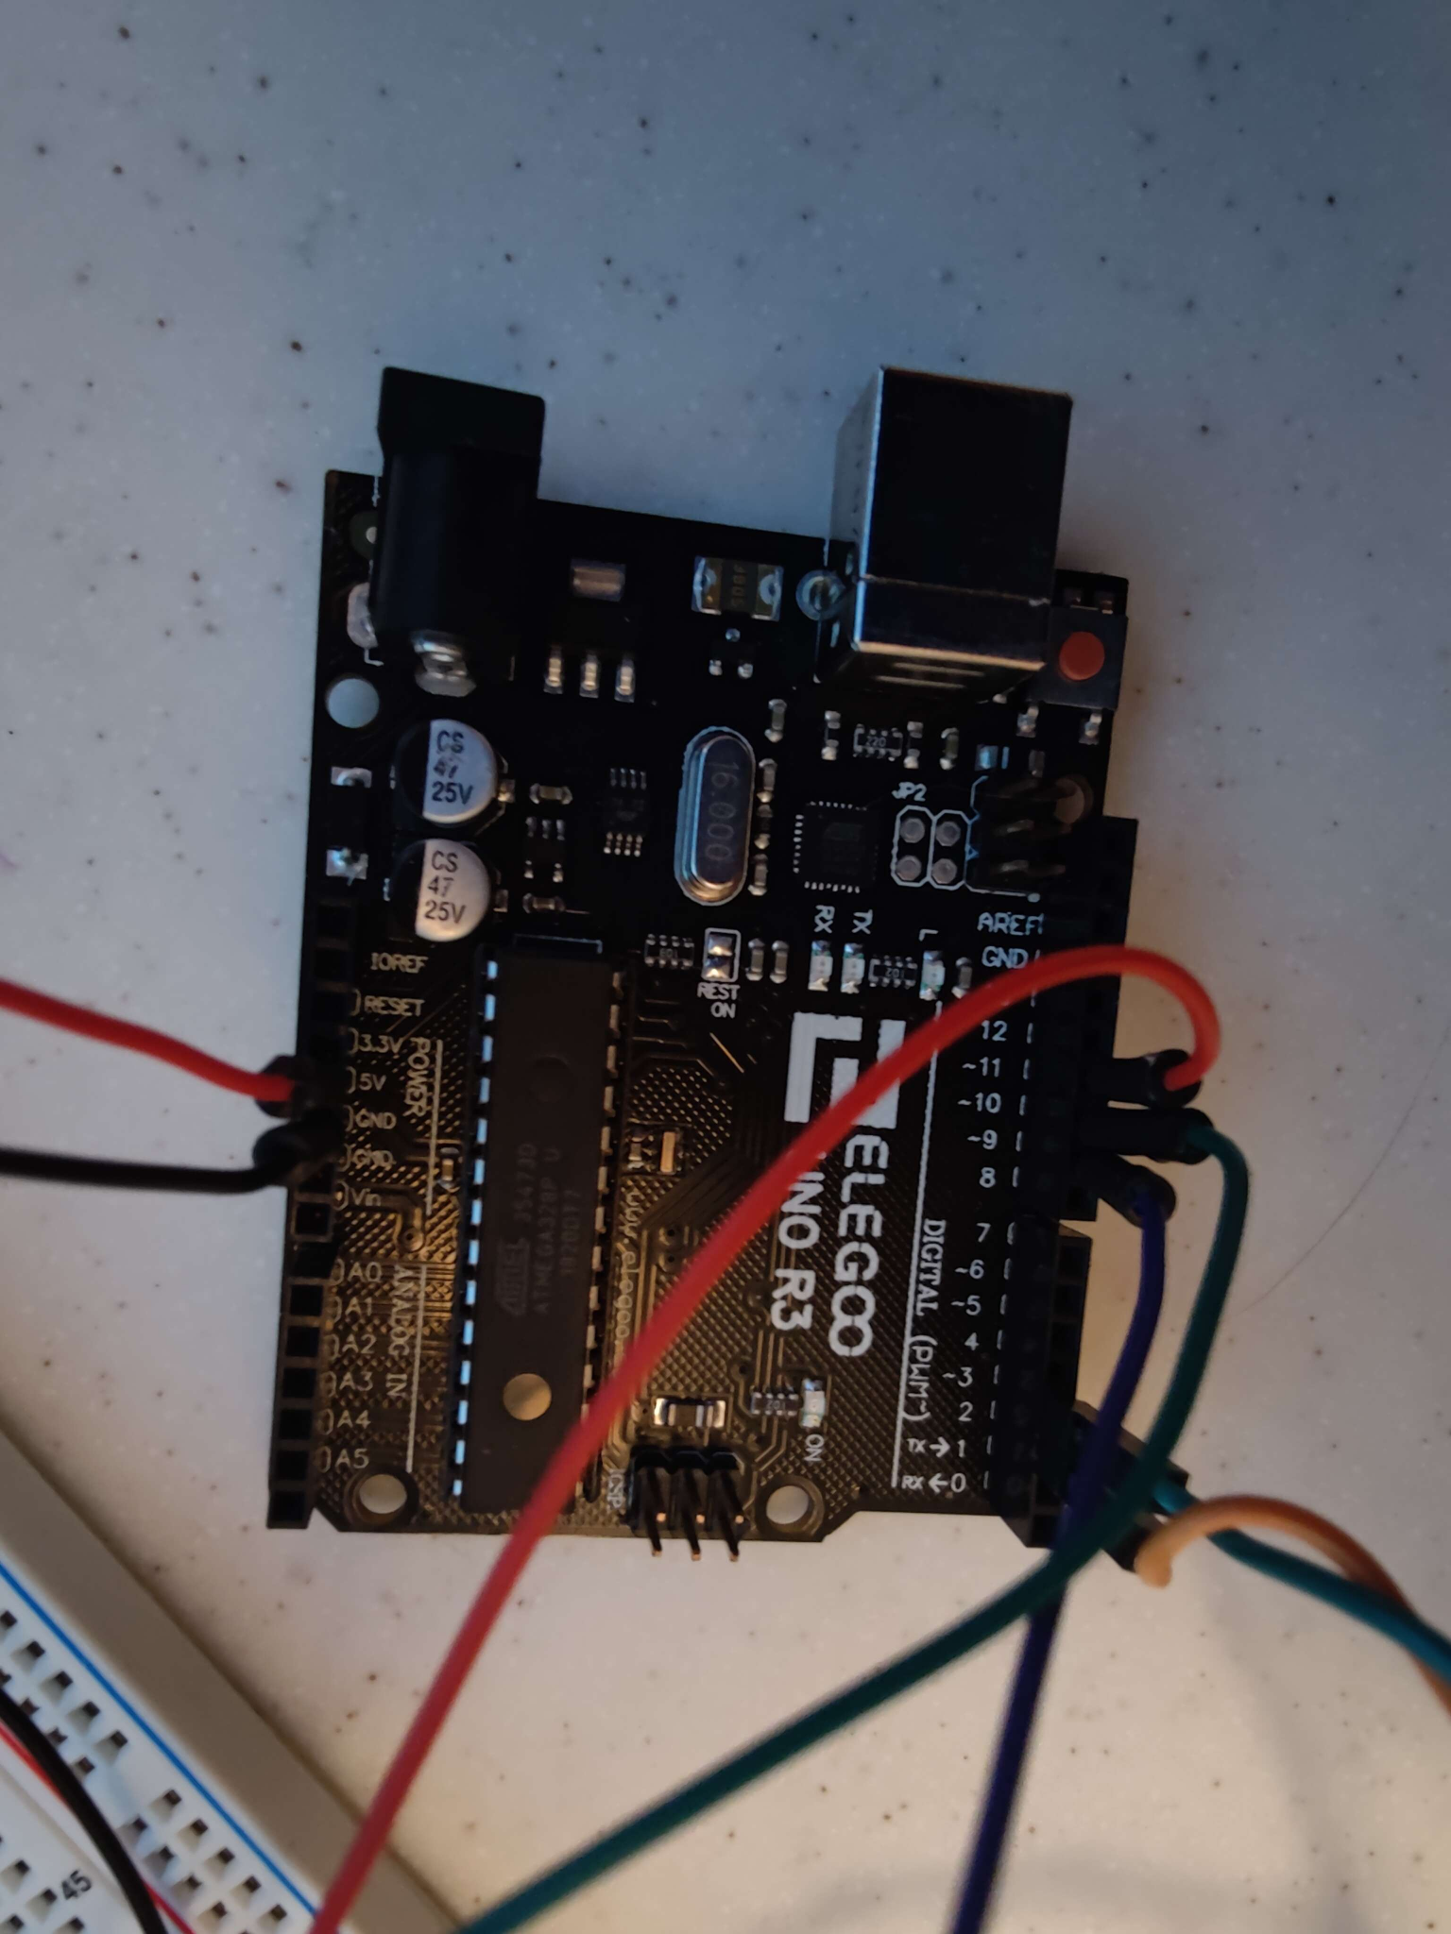
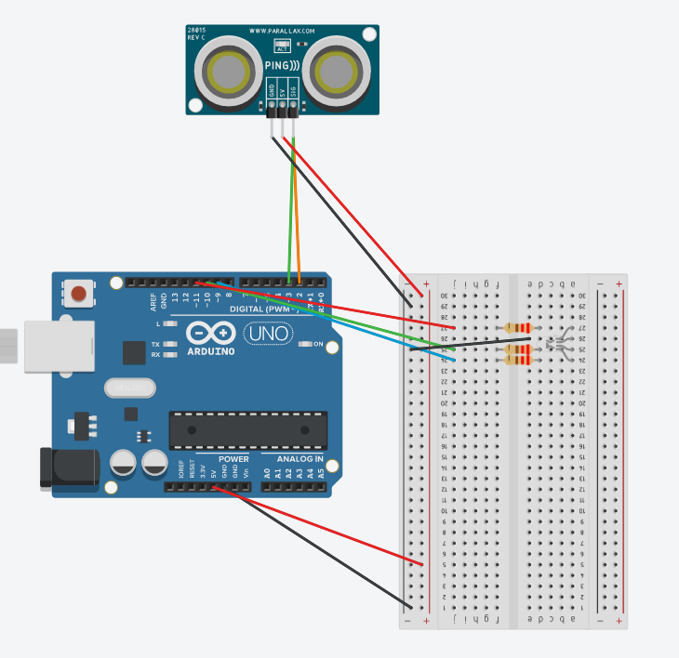
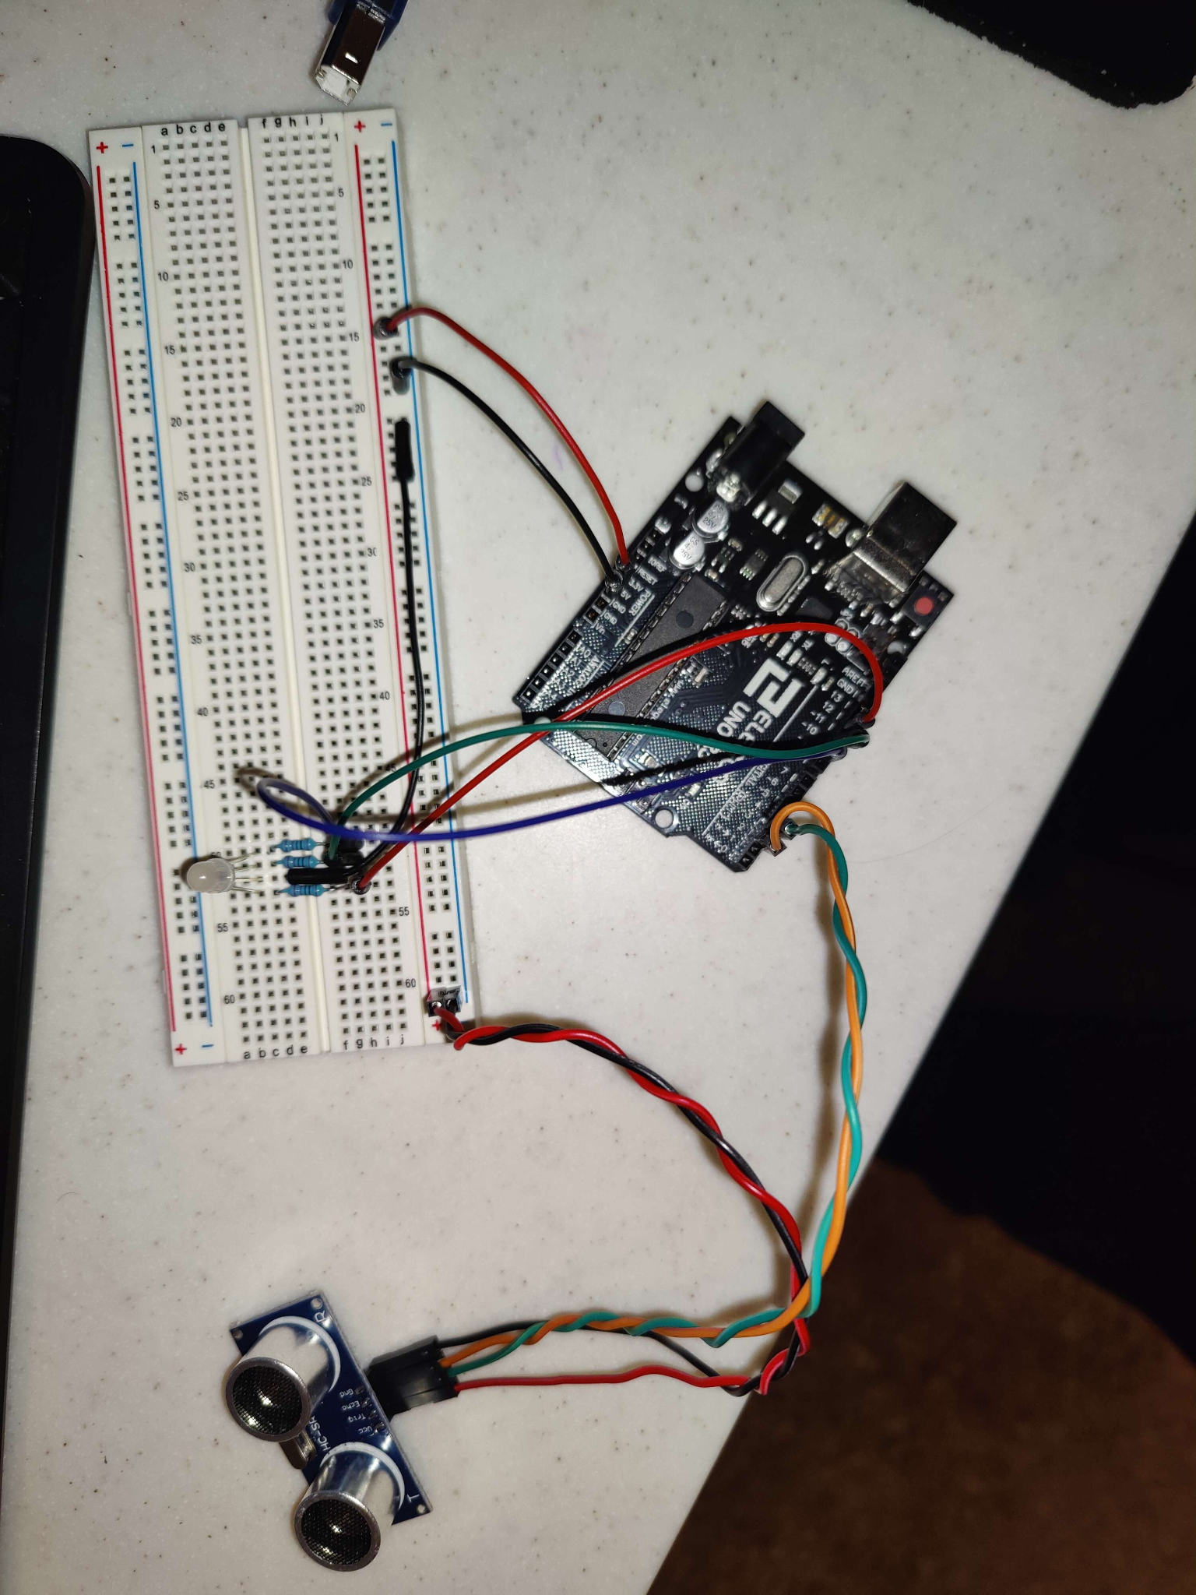
Arduino Circuit

Slide 7
Testing
Controlled Environment
Small scale, 90cm run on desk.
Seemed accurate down to centimeter scale
CONS:
Material
Object angle
Large Scale, 9ft run in room
Inaccurate - space constraints and Sensor Angles.
Android Phone link
Arduinodroid - Arduino IDE and serial monitor
Future Testing
Emphasis on Large Scale, outdoor environment

Slide 8
Demo!

Slide 9
Future Features
Camera-based AI object identification
Safety Light added to rear sensor
Speed/direction display via mobile sensors
Accident/Fall Detection with emergency notifications

Slide 10
References
https://www.cdc.gov/transportationsafety/bicycle/index.html
https://www.youtube.com/watch?v=RPCDX7T3nGc
https://ieeexplore.ieee.org/abstract/document/5309876?casa_token=-3ErGHIOThkAAAAA:AM3t8pBkJI0PslfshIKESQvzGEBFD1SejiehJs0RVoklUS3BL7OabMMiS6XO85xYrvgi68iBmrU
https://link.springer.com/chapter/10.1007/978-3-319-48021-3_12

